Slide 1
LOGISTIC REGRESSION
P : 080 4928 5000 | E : enquiry@acadgild.com

Slide 2
Regression
Regression analysis investigates relationship between dependent (target) and independent variable(s) (predictor).
Used for forecasting, time series modelling and finding causal relationships between variables.
Determines significant relationships between independent and dependent variables.
Determines strength of impact of multiple independent variables on dependent variables.
Allows to find relationships between variables measured at different scales.

Slide 3
CLASSIFICATION
Classification in Machine Learning is a technique of learning where a particular instance is mapped to one of many labels.
The machine learns patterns from data in such a way that the learned representation successfully maps the original dimension to the suggested label/class without any more intervention from a human expert.

Slide 4
GENERALIZED LINEAR MODEL
Generalizes linear regression by allowing response variable to be related to the linear model via a link function.
When the response variable has a normal distribution, a constant change in predictor also causes a constant change in response variables.
Linear regression not suitable when the above assumption is not true, or even in the case of a bernoulli variable which takes one of two values.
The GLM has 3 elements:
1) A probability distribution from the exponential family.
2) A linear predictor.
3) A link function.
g(E(y)) = α + βx1 + γx2

Slide 5
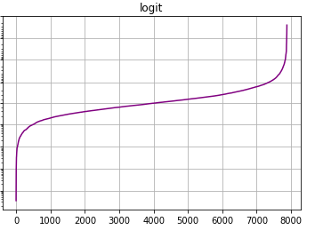
LOGIT FUNCTION
When the variable represents probability p, it gives the log odds or the logarithm of the odds, given as p / (1 – p)
Odds – probability of success / probability of failure
Given the probability that party A has 20% chance of winning, its odds ratio is 0.20 / 0.80 = 0.25
Inverse of logistic function.
Logistic function:
Logit function:
${e^{x}}/{\left(1+e^{x}\right)}$
$log\left(p/{\left(1–p\right)}\right)$

Slide 6
BINARY LOGISTIC REGRESSION
Two possible outcomes – 0 and 1.
Estimates parameters of a logit model.
Log-odds of an event occuring is a linear combination of predictor or independent variables.
Example scenarios – whether someone will get sick, whether a political party will win in an election, etc.
$ln\left(\frac{p}{1−p}\right)=B_{0}X_{0i}+B_{1}X_{1i}+B_{2}X_{2I}+....$
p – probability of response variable being 1
1 – p -probabiliy of response variable being 0.

Slide 7
ASSUMPTIONS
Binary regression requires dependent variable to be binary.
The dependent variable need not be normal.
Sample size should be sufficient – atleast 50 records per predictor.

Slide 8
MAXIMUM LIKELIHOOD ESTIMATE
Method of estimating the parameters of a statistical model, given some observations.
The likelihood of observing the samples, given that the samples are drawn from a given distribution with certain parameters is maximized.
The goal of MLE is to maximize L = f(x₁, x₂, x₃, ....x_{n} | θ)
A sequence of MLEs on increasing number of observations will converge to the true values of the population.

Slide 9
MULTI-CLASS LOGISTIC REGRESSION
Generalizes logistic regression to multi-class problems.
Examples – Which course will a student choose given grades, interests?
Which party will win, given demographics of people voting?
Which blood group does an individual have, given the results of diagnostic tests?
Assumption – Independence of Irrelevant Alternatives

Slide 10
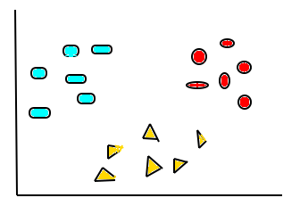
ONE VS REST
For each class, a binary classification problem – whether it belongs to thec class or not
IsEllipse?
IsRect?
Yes
No
Yes
No
C = 1
C = 2
IsTriangle?
Yes
No
C = 3

Slide 11
MULTINOMIAL LOGISTIC REGRESSION
Used when the dependent variable is nominal with more than 2 levels
Nominal – variable with no intrinsic ordering
With a multinomial logit model you impose the constraint that all the predicted probabilities add up to 1

Slide 12
Evaluating Performance of a Logistic Regression Model
AIC (Akaike Information Criteria)
Null Deviance and Residual Deviance
Confusion Matrix
ROC Curve (Receiver Operating Characteristic Curve)
PREDICTED
 |  | PASS | FAIL
ACTUAL | PASS | TP | FN
 | FAIL | FP | TN

Slide 13
BIKE SHARING DATASET
https://archive.ics.uci.edu/ml/datasets/bike+sharing+dataset

Slide 14
STEPS TO IMPLEMENT LOGISTIC REGRESSION IN PYTHON
Import the necessary libraries
Load the data set
Select predictor and target variables
Split the data into train and test data
Fit the model to the data
Evaluate model

